Slide 2
Topics
Introduction
Hardware and Software
How Computers Store Data
How a Program Works
Using Python

Slide 3
Introduction
Computers can be programmed
  Designed to do any job that a program tells them to
Program: set of instructions that a computer follows to perform a task
  Commonly referred to as Software
Programmer: person who can design, create, and test computer programs
  Also known as software developer

Slide 4

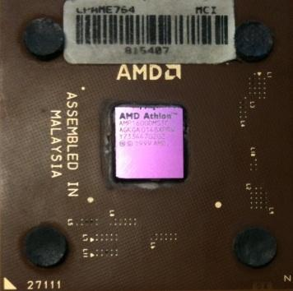
Computers Want to be Helpful...
Computers are built for one purpose - to do things for us
But we need to speak their language to describe what we want done
Users have it easy - someone already put many different programs (instructions) into the computer and users just pick the ones they want to use
What
Next?
What
Next?
What
Next?
What
Next?
What
Next?
What
Next?
What
Next?

Slide 5
Users vs. Programmers
Users see computers as a set of tools - word processor, spreadsheet, map, to-do list, etc.
Programmers learn the computer “ways” and the computer language
Programmers have some tools that allow them to build new tools
Programmers sometimes write tools for lots of users and sometimes programmers write little “helpers” for themselves to automate a task

Slide 6
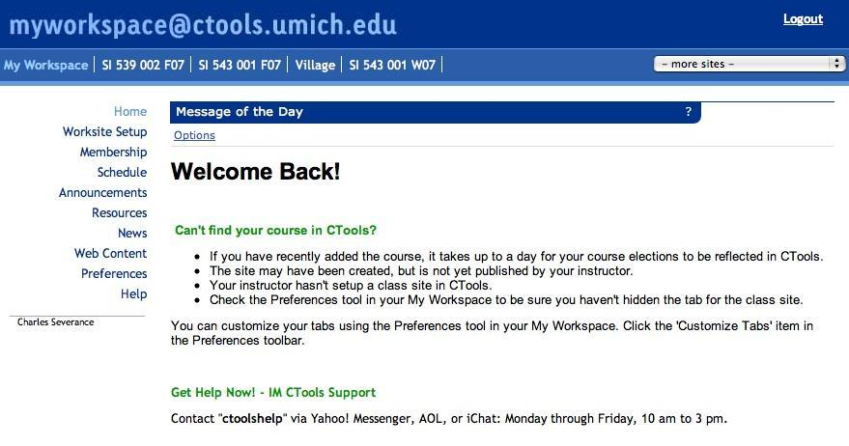
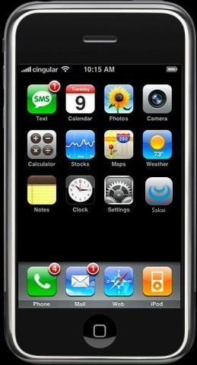

User
Computer
Hardware + Software
Programmer
Data
Information
Networks
....
From a software creator’s point of view, we build the software. The end users (stakeholders/actors) are our masters - who we want to please - often they pay us money when they are pleased. But the data, information, and networks are our problem to solve on their behalf. The hardware and software are our friends and allies in this quest.

Slide 7
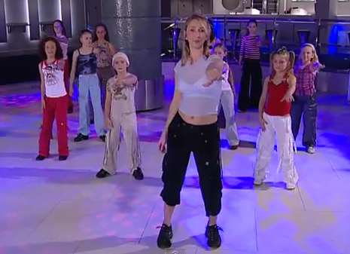
Programs for Humans...
https://www.youtube.com/watch?v=XiBYM6g8Tck

Slide 8
Programs for Humans...
while music is playing:
    Left hand out and up
    Right hand out and up
    Flip Left hand
    Flip Right hand
    Left hand to right shoulder
    Right hand to left shoulder
    Left hand to back of head
    Right ham to back of head
    Left hand to right hit
    Right hand to left hit
    Left hand on left bottom
    Right hand on right bottom
    Wiggle
    Wiggle
    Jump
https://www.youtube.com/watch?v=XiBYM6g8Tck

Slide 9
Programs for Humans...
while music is playing:
    Left hand out and up
    Right hand out and up
    Flip Left hand
    Flip Right hand
    Left hand to right shoulder
    Right hand to left shoulder
    Left hand to back of head
    Right ham to back of head
    Left hand to right hit
    Right hand to left hit
    Left hand on left bottom
    Right hand on right bottom
    Wiggle
    Wiggle
    Jump
https://www.youtube.com/watch?v=XiBYM6g8Tck

Slide 10
Programs for Humans...
while music is playing:
    Left hand out and up
    Right hand out and up
    Flip Left hand
    Flip Right hand
    Left hand to right shoulder
    Right hand to left shoulder
    Left hand to back of head
    Right hand to back of head
    Left hand to right hip
    Right hand to left hip
    Left hand on left bottom
    Right hand on right bottom
    Wiggle
    Wiggle
    Jump
https://www.youtube.com/watch?v=XiBYM6g8Tck

Slide 11
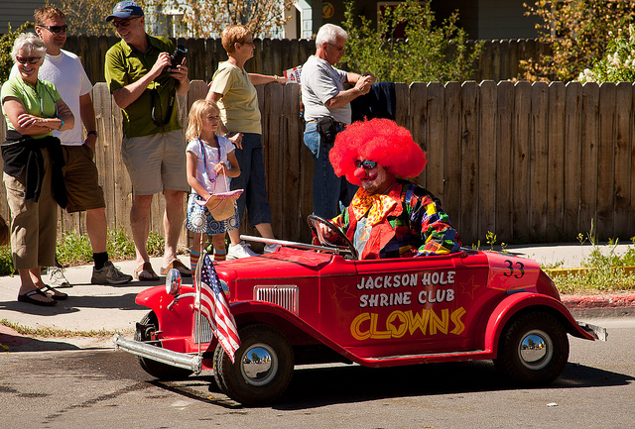
Programs for Python...
the clown ran after the car and the car ran into the tent and the tent fell down on the clown and the car

Slide 12
name = input('Enter file:')
handle = open(name)
counts = dict()
for line in handle:
words = line.split()
for word in words:
counts[word] = counts.get(word,0) + 1
bigcount = None
bigword = None
for word,count in counts.items():
if bigcount is None or count > bigcount:
bigword = word
bigcount = count
print(bigword, bigcount)
python words.py
Enter file: clown.txt
the 7
A short “story” about how to count words in a file in Python

Slide 13
Hardware and Software
Hardware: The physical devices that make up a computer
  Computer is a system composed of several components that all work together
Typical major components:
  Central processing unit
  Main memory
  Secondary storage devices
  Input and output devices

Slide 14
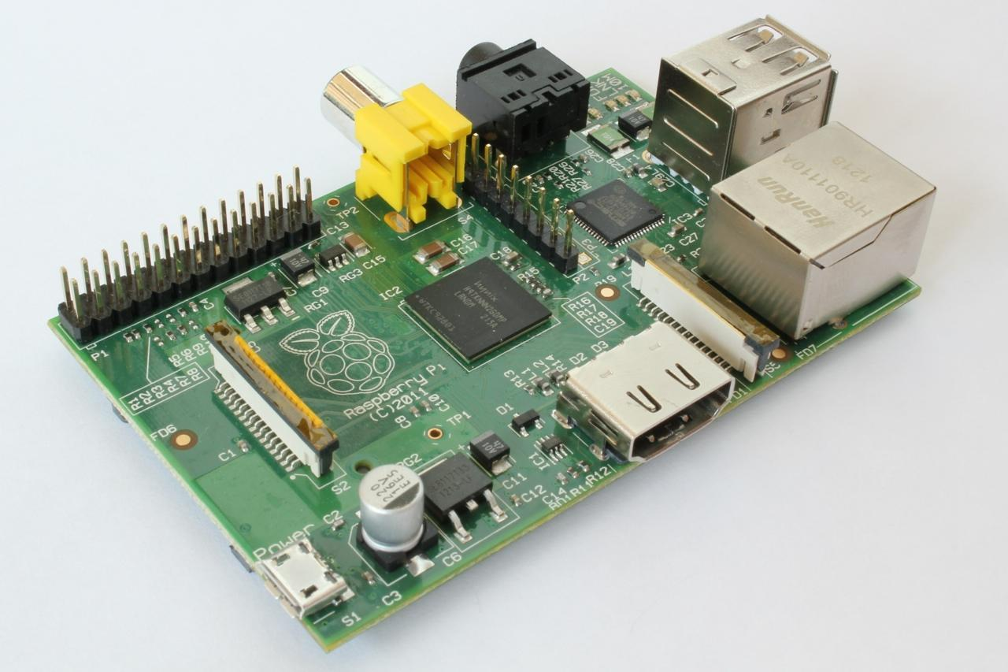

Slide 15
What
Next?
Generic
Computer
Software
Input
and Output
Devices
Central
Processing
Unit
Secondary
Memory
Main
Memory

Slide 16
The CPU
Central processing unit (CPU): the part of the computer that actually runs programs
  Most important component
  Without it, cannot run software
  Used to be a huge device
  Not the brains exactly - very dumb but very very fast
Microprocessors: CPUs located on small chips

Slide 17
Main Memory
Main memory: where computer stores a program while program is running, and data used by the program
Known as Random Access Memory or RAM
  CPU is able to quickly access data in RAM
  Volatile memory used for temporary storage while program is running
  Contents are erased when computer is off

Slide 18
Secondary Storage Devices
Secondary storage: can hold data for long periods of time
  Programs normally stored here and loaded to main memory when needed (lasts until deleted)
Types of secondary memory
  Disk drive: magnetically encodes data onto a spinning circular disk
  Solid state drive: faster than disk drive, no moving parts, stores data in solid state memory
  Flash memory: portable, no physical disk
  Optical devices: data encoded optically

Slide 19
Input Devices
Input: data the computer collects from people and other devices
Input device: component that collects the data
  Examples: keyboard, mouse, touchscreen, scanner, camera
  Disk drives can be considered input devices because they load programs into the main memory

Slide 20
Output Devices
Output: data produced by the computer for other people or devices
  Can be text, image, audio, or bit stream
Output device: formats and presents output
  Examples: video display, printer
  Disk drives and USB drives can be considered output devices because data is sent to them to be saved

Slide 21
What
Next?
Generic
Computer
Software
Input
and Output
Devices
Central
Processing
Unit
Secondary
Memory
if x< 3: print
Main
Memory

Slide 22
What
Next?
Generic
Computer
Software
Input
and Output
Devices
Central
Processing
Unit
Secondary
Memory
01001001
00111001
Main
Memory
Machine
Language

Slide 23
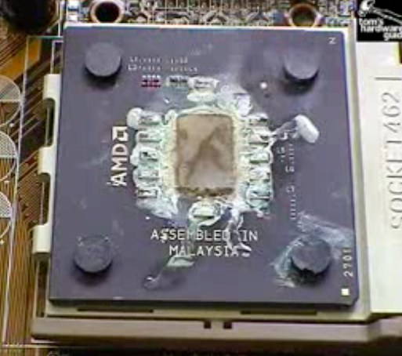
Totally Hot CPU
What
Next?
http://www.youtube.com/watch?v=y39D4529FM4

Slide 24
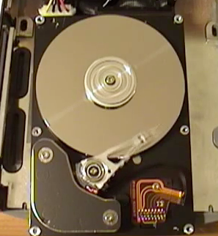
Hard Disk in Action
http://www.youtube.com/watch?v=9eMWG3fwiEU

Slide 25
Software
Everything the computer does is controlled by software
  General categories:
    Application software
    System software
Application software: programs that make computer useful for every day tasks
  Examples: word processing, email, games, and Web browsers

Slide 26
Software (cont’d.)
System software: programs that control and manage basic operations of a computer
  Operating system: controls operations of hardware components
  Utility Program: performs specific task to enhance computer operation or safeguard data
  Software development tools: used to create, modify, and test software programs

Slide 27
How Computers Store Data
All data in a computer is stored in sequences of 0s and 1s
Byte: just enough memory to store letter or small number
  Divided into eight bits
  Bit: electrical component that can hold positive or negative charge, like on/off switch
  The on/off pattern of bits in a byte represents data stored in the byte

Slide 28
Storing Numbers
Bit represents two values, 0 and 1
Computers use binary numbering system
  Position of digit j is assigned the value 2^{j-1}
  To determine value of binary number sum position values of the 1s
Byte size limits are 0 and 255
  0 = all bits off; 255 = all bits on
  To store larger number, use several bytes

Slide 29
Storing Characters
Data stored in computer must be stored as binary number
Characters are converted to numeric code, numeric code stored in memory
  Most important coding scheme is ASCII
    ASCII (American Standard Code for Information Interchange) is limited: defines codes for only 128 characters
  Unicode coding scheme becoming standard
    Compatible with ASCII
    Can represent characters for other languages

Slide 30
Advanced Number Storage
To store negative numbers and real numbers, computers use binary numbering and encoding schemes
  Negative numbers encoded using two’s complement
  Real numbers encoded using floating-point notation

Slide 31
Other Types of Data
Digital: describes any device that stores data as binary numbers
Digital images are composed of pixels
  To store images, each pixel is converted to a binary number representing the pixel’s color
Digital music is composed of sections called samples
  To store music, each sample is converted to a binary number

Slide 32
How a Program Works
CPU designed to perform simple operations on pieces of data
  Examples: reading data, adding, subtracting, multiplying, and dividing numbers
  Understands instructions written in machine language and included in its instruction set
    Each brand of CPU has its own instruction set
To carry out meaningful calculation, CPU must perform many operations

Slide 33
How a Program Works (cont’d.)
Program must be copied from secondary memory to RAM each time CPU executes it
CPU executes program in cycle:
  Fetch: read the next instruction from memory into CPU
  Decode: CPU decodes fetched instruction to determine which operation to perform
  Execute: perform the operation

Slide 34
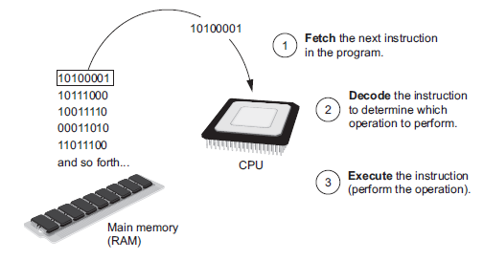
How a Program Works (cont’d.)
Figure 1-16 The fetch-decode-execute cycle

Slide 35
From Machine Language to Assembly Language
Impractical for people to write in machine language
Assembly language: uses short words (mnemonics) for instructions instead of binary numbers
  Easier for programmers to work with
Assembler: translates assembly language to machine language for execution by CPU

Slide 36
High-Level Languages
Low-level language: close in nature to machine language
  Example: assembly language
High-Level language: allows simple creation of powerful and complex programs
  No need to know how CPU works or write large number of instructions
  More intuitive to understand

Slide 37
Key Words, Operators, and Syntax: an Overview
Key words: predefined words used to write program in high-level language
  Each key word has specific meaning
Operators: perform operations on data
  Example: math operators to perform arithmetic
Syntax: set of rules to be followed when writing program
Statement: individual instruction used in high-level language

Slide 38
Reserved Words
You cannot use reserved words as variable names / identifiers
False class return is finally
None if for lambda continue
True def from while nonlocal
and del global not with
as elif try or yield
assert else import pass
break except in raise

Slide 39
Compilers and Interpreters
Programs written in high-level languages must be translated into machine language to be executed
Compiler: translates high-level language program into separate machine language program
  Machine language program can be executed at any time

Slide 40
Compilers and Interpreters (cont’d.)
Interpreter: translates and executes instructions in high-level language program
  Used by Python language
  Interprets one instruction at a time
  No separate machine language program
Source code: statements written by programmer
  Syntax error: prevents code from being translated

Slide 41
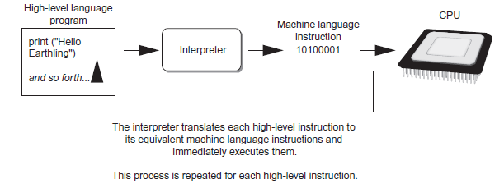
Compilers and Interpreters (cont’d.)
Figure 1-19 Executing a high-level program with an interpreter

Slide 42
COMPILER | INTERPRETER
1. It translates the full source code at a time. | 1. It translates one line of code at a time.
2. It translates one line of code at a time. | 2. Comparatively slower.
3. It uses more memory to perform. | 3. The interpreter uses less memory than the compiler to perform.
4. Error detection is difficult for the compiler. | 4. Error detection is easier for the interpreter.
5. It shows error alert after scanning the full program. | 5. Whenever it finds any error it stops there.
6. Before execution of a program, the compilation is done. | 6. Compilation and execution for a program are done simultaneously.

Slide 43
Python as a Language

Slide 44
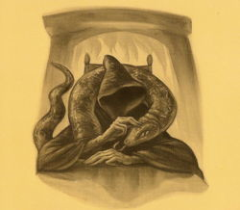
Parseltongue is the language of serpents and those who can converse with them. An individual who can speak Parseltongue is known as a Parselmouth. It is a very uncommon skill, and may be hereditary. Nearly all known Parselmouths are descended from Salazar Slytherin.
http://harrypotter.wikia.com/wiki/Parseltongue

Slide 45
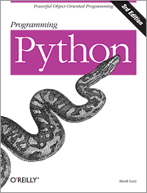
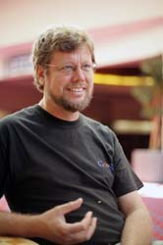
Python is the language of the Python Interpreter and those who can converse with it. An individual who can speak Python is known as a Pythonista. It is a very uncommon skill, and may be hereditary. Nearly all known Pythonistas use software initially developed by Guido van Rossum.

Slide 46
Early Learner: Syntax Errors
We need to learn the Python language so we can communicate our instructions to Python. In the beginning we will make lots of mistakes and speak gibberish like small children.
When you make a mistake, the computer does not think you are “cute”. It says “syntax error” - given that it knows the language and you are just learning it. It seems like Python is cruel and unfeeling.
You must remember that you are intelligent and can learn. The computer is simple and very fast, but cannot learn. So it is easier for you to learn Python than for the computer to learn English...

Slide 47
Using Python
Python must be installed and configured prior to use
  One of the items installed is the Python interpreter
Python interpreter can be used in two modes:
  Interactive mode: enter statements on keyboard
  Script mode: save statements in Python script

Slide 48
Interactive Mode
When you start Python in interactive mode, you will see a prompt
  Indicates the interpreter is waiting for a Python statement to be typed
  Prompt reappears after previous statement is executed
  Error message displayed If you incorrectly type a statement
Good way to learn new parts of Python

Slide 49
csev$ python3
Python 3.5.1 (v3.5.1:37a07cee5969, Dec 5 2015, 21:12:44) [GCC 4.2.1 (Apple Inc. build 5666) (dot 3)] on darwinType "help", "copyright", "credits" or "license" for more information.
>>>
What next?

Slide 50
csev$ python3
Python 3.5.1 (v3.5.1:37a07cee5969, Dec 5 2015, 21:12:44) [GCC 4.2.1 (Apple Inc. build 5666) (dot 3)] on darwinType "help", "copyright", "credits" or "license" for more information.
>>> x = 1
>>> print(x)
1
>>> x = x + 1
>>> print(x)
2
>>> exit()
This is a good test to make sure that you have Python correctly installed. Note that quit() also works to end the interactive session.

Slide 51
Sentences or Lines
x = 2
x = x + 2
print(x)
Assignment statement
Assignment with expression
Print statement
Variable
Operator
Constant
Function

Slide 52
Writing Python Programs and Running Them in Script Mode
Statements entered in interactive mode are not saved as a program
To have a program use script mode
  Save a set of Python statements in a file
  The filename should have the .py extension
  To run the file, or script, type
  python filename
  at the operating system command line

Slide 53
Interactive versus Script
Interactive
  - You type directly to Python one line at a time and it responds
Script
  - You enter a sequence of statements (lines) into a file using a text editor and tell Python to execute the statements in the file

Slide 54
The IDLE Programming Environment
IDLE (Integrated Development Program): single program that provides tools to write, execute and test a program
  Automatically installed when Python language is installed
  Runs in interactive mode
  Has built-in text editor with features designed to help write Python programs

Slide 55
Program Steps or Program Flow
Like a recipe or installation instructions, a program is a sequence of steps to be done in order.
Some steps are conditional - they may be skipped.
Sometimes a step or group of steps is to be repeated.

Slide 56
Sequential Steps
x = 2
Program:
x = 2
print(x)
x = x + 2
print(x)
Output:
2
4
print(x)
x = x + 2
print(x)
When a program is running, it flows from one step to the next. As programmers, we set up “paths” for the program to follow.

Slide 57
Conditional Steps
x = 5
x < 10 ?
Yes
Program:
x = 5
if x < 10:
print('Smaller')
if x > 20:
print('Bigger')
print('Finis')
print('Smaller')
Output:
Smaller
Finis
No
x > 20 ?
Yes
No
print('Bigger')
print('Finis')

Slide 58
Repeated Steps
n = 5
No
n > 0 ?
Yes
Program:
n = 5
while n > 0 :
print(n)
n = n – 1
print('Blastoff!')
Output:
5
4
3
2
1
Blastoff!
print(n)
n = n -1
print('Blastoff')
Loops (repeated steps) have iteration variables that change each time through a loop.

Slide 59
name = input('Enter file:')
handle = open(name, 'r')
counts = dict()
for line in handle:
words = line.split()
for word in words:
counts[word] = counts.get(word,0) + 1
bigcount = None
bigword = None
for word,count in counts.items():
if bigcount is None or count > bigcount:
bigword = word
bigcount = count
print(bigword, bigcount)
Sequential
Repeated
Conditional

Slide 60
name = input('Enter file:')
handle = open(name, 'r')
counts = dict()
for line in handle:
words = line.split()
for word in words:
counts[word] = counts.get(word,0) + 1
bigcount = None
bigword = None
for word,count in counts.items():
if bigcount is None or count > bigcount:
bigword = word
bigcount = count
print(bigword, bigcount)
A short Python “Story” about how to count words in a file
A word used to read data from a user
A sentence about updating one of the many counts
A paragraph about how to find the largest item in a list

Slide 61
Summary
This chapter covered:
  Main hardware components of the computer
  Types of software
  How data is stored in a computer
  Basic CPU operations and machine language
  Fetch-decode-execute cycle
  Complex languages and their translation to machine code
  Installing Python and the Python interpreter modes

Slide 62

Acknowledgements / Contributions
These slides are Copyright 2010- Charles R. Severance (www.dr-chuck.com) of the University of Michigan School of Information and made available under a Creative Commons Attribution 4.0 License. Please maintain this last slide in all copies of the document to comply with the attribution requirements of the license. If you make a change, feel free to add your name and organization to the list of contributors on this page as you republish the materials.
Initial Development: Charles Severance, University of Michigan School of Information
… Insert new Contributors and Translators here
Continue…

